Slide 1
AI-Powered Collections Strategy
Leveraging Agentic AI for Scalable, Fair, and Effective Debt Management at Geldium

Slide 2
How the System Works
Inputs: Customer demographics, Payment history, Credit score, Credit utilization, Income & loan balance
Decision Logic: AI analyzes customer data to predict delinquency risk and classifies customers as Low, Medium, or High Risk.
Action Triggers:
Low Risk: Automated payment reminders.
Medium Risk: Personalized SMS/email reminders with self-service payment options.
High Risk: Referred to Collections specialists with AI-generated risk insights.
Learning Loop: The system monitors repayment outcomes and continuously updates predictions to improve future decisions.

Slide 3
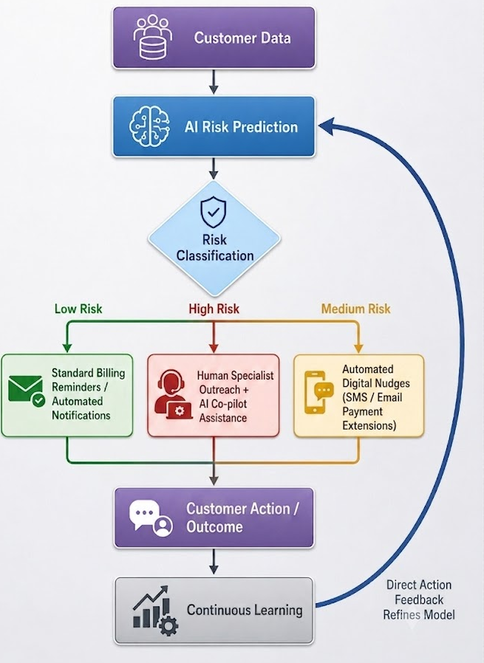
System Workflow

Slide 4
Role of Agentic AI
Autonomous (AI) | Human-in-the-Loop
Predict customer delinquency risk | Review high-risk cases
Classify customers into risk levels | Approve hardship plans or payment restructuring
Send automated payment reminders | Make final decisions on complex collection cases
Monitor repayment behavior and update risk scores | Monitor AI performance and address customer appeals

Slide 5
Responsible AI Guardrails
Guardrail | Description
Fairness Checks | Regularly test the model to ensure predictions are unbiased across different customer groups.
Explainability | Provide clear reasons for each risk prediction using feature importance or model explanations.
Regulatory Compliance | Ensure customer data and AI decisions comply with applicable financial and privacy regulations (e.g., ECOA, GDPR, or local laws).
Human Oversight | Human reviewers make final decisions for high-risk cases and hardship requests instead of relying solely on AI.
Continuous Monitoring | Monitor model performance and retrain the model periodically to maintain accuracy and fairness.

Slide 6
Expected Business Impact
Business KPIs
Reduced delinquency rates through early intervention.
Improved repayment and recovery rates.
More efficient allocation of collection resources.
Reduced manual workload and operational costs.
Faster, data-driven decision-making.

Slide 7
Expected Business Impact
Customer Outcomes
Personalized and timely payment support.
Fair and transparent AI-assisted decisions.
Improved customer experience and trust.
Early assistance before financial problems worsen.
Scalable and consistent collection process.

Slide 8
Thank You

